Slide 1
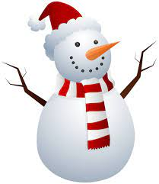
Mrs. Lefeld
The Third Grade Wave
January 2024
Important Dates
January 3rd – Welcome back!
January 12th-End of First Semester
January 15th – MLK, Jr. Day
No School
January 16th – Teacher Workday
No School
January 19th – Report Cards
January 29-No School-Staff In-Service day
Special Notes
Our Winter Party was a lot of fun! THANK YOU to everyone who sent in treats! The kids really enjoyed them!! 😁
Each night, your child should be practicing their spelling words and reading for 20 minutes. If your child needs a text to read, please have them borrow from our classroom library!
January reading log will be due on February 1st!
Learning Targets – January
❄Reading❄
This month, we will be finishing up folktales. With this, we will be writing summaries using the “Somebody, Wanted, But, So, Then” strategy, and identifying themes with supporting evidence.
After, we will move into poetry, with a focus in reading for meaning, identifying the author’s point of view, and understanding the use of figurative language. We will also discuss the differences between the elements of poetry and traditionally written texts (prose).
Example: Poetry uses lines and stanzas, rather than sentences and paragraphs.
❄Writing❄
In writing, students will be applying their summarizing skills learned in reading to help them add text evidence to support their thoughts in a piece of writing.
Students will begin learning how to write informative, multi-paragraph pieces that:
clearly introduce a topic
support the topic with details
use transition words to connect ideas
provide a concluding statement
❄Grammar❄
In grammar, we will continue build our understanding of proper sentence structure and grammar usage within our writing.

